Slide 1
SparseFool: a few pixels make a big difference
CVPR 2019 Poster
Notes:
The last two authors are also the authors of DeepFool

Slide 2
Sparse Perturbations
What is “Sparse Perturbations” ?
Altering only a small fraction of the input and DNNs will misclassify an image
Existing Method
JSMA 、Evolutionary Algorithms 、Greedy local search Algorithm
Problems
1. High complexity.
2. High magnitude noise.
3. Exceed the dynamic range of the image.
Notes:
JSMA: perturbs the pixels based on their Saliency score
Problems:
Current algorithms are all characterized by high complexity.
The resulting perturbations usually consist of high magnitude noise, concentrated over a small number of pixels. This makes them quite perceptible.
In many cases, the perturbed pixels might even exceed the dynamic range of the image.

Slide 3
Motivation
Efﬁcient way to compute sparse perturbations.
Ensure the validity of the perturbed pixels.
Constraints
1.The number of pixels changed should be as small as possible. !!!!
(sparse perturbation)
2.The magnitude of each perturbed pixel should be as small as possible. !!
(validity)

Slide 4
SparseFool
If the boundary is a line (2D)
$$y$$
$$x$$
$$x$$

Slide 5
SparseFool
If the boundary is a line (2D)
$$y$$
$$x$$
$$x$$

Slide 6
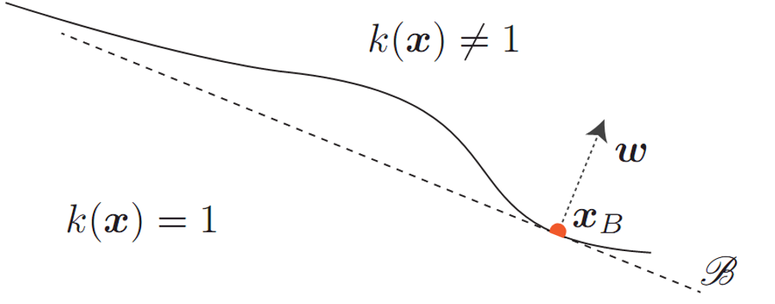
SparseFool
If the boundary is not a line, but we know a point on the boundary (2D)
$$y$$
$$x$$
The final direction of movement
$$x$$
$$=$$
The direction of the largest vector component

Slide 7
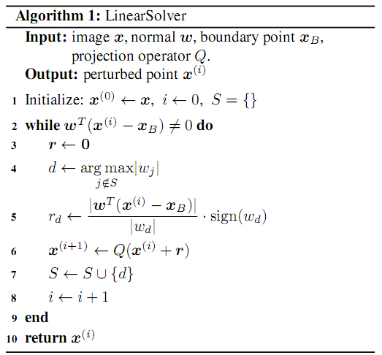
SparseFool
If the boundary is not a line, but we know a point on the boundary (high dimensional)
find the largest component
compute the perturbation
readjust the values of the updated point that are out of bounds
Eg. $\left[0,255\right]$ (bound) 268 (updated point value)
255

Slide 8
SparseFool
If the boundary is not a line, but we know a point on the boundary (2D)
$$y$$
$$x$$
$$x$$

Slide 9
SparseFool
How to get the point on the boundary?
$$x_{B}^{(1)}$$
DeepFool can find it !
$$x^{(2)}$$
$$x^{(1)}$$
$$x_{B}^{(0)}$$
$$x^{(0)}$$

Slide 10
Experiments
Average Run Time

Slide 11
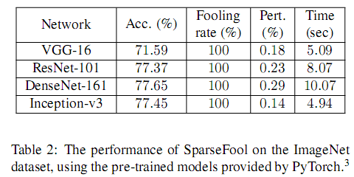
Experiments
Average Run Time

Slide 12
Experiments
Perturbed Pixels
$$max⁡\{0,x_{i}−δ\}≤{\hat{x}}_{i}≤min⁡\{255,x_{i}+δ\}$$

Slide 13
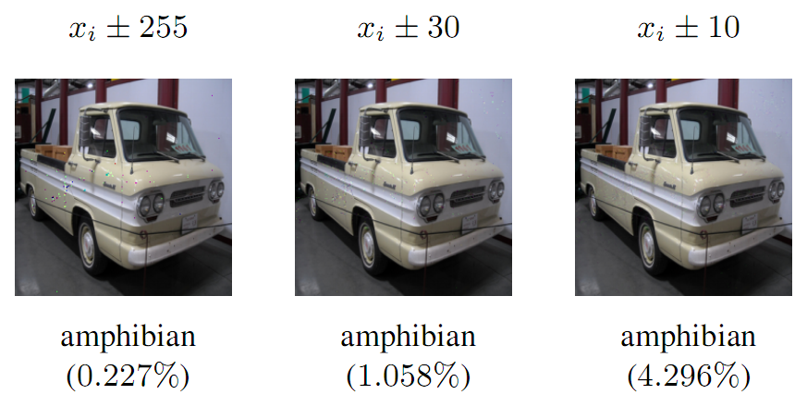
Experiments
Perturbed Pixels
$$max⁡\{0,x_{i}−δ\}≤{\hat{x}}_{i}≤min⁡\{255,x_{i}+δ\}$$
amphibian
两栖动物

Slide 14
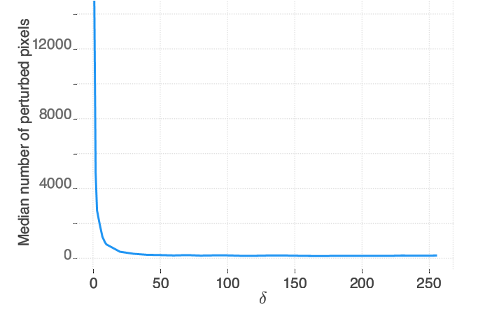
Experiments
Perturbed Pixels
Notes:
Observe though that after 25, the sparsity levels seem to remain almost constant.

Slide 15
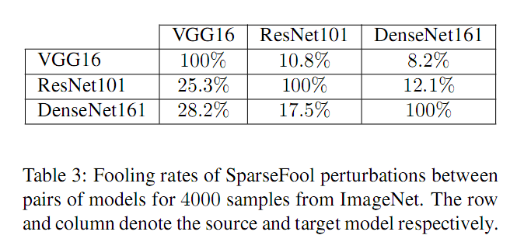
Experiments
Transferability

Slide 16
Conclusion
Provide a novel geometry inspired sparse attack algorithm that is fast and can scale to high dimensional data.
Comments
Average time on generating adversarial samples on ImageNet dataset is still long.
Transferability is not good.

